Slide 1
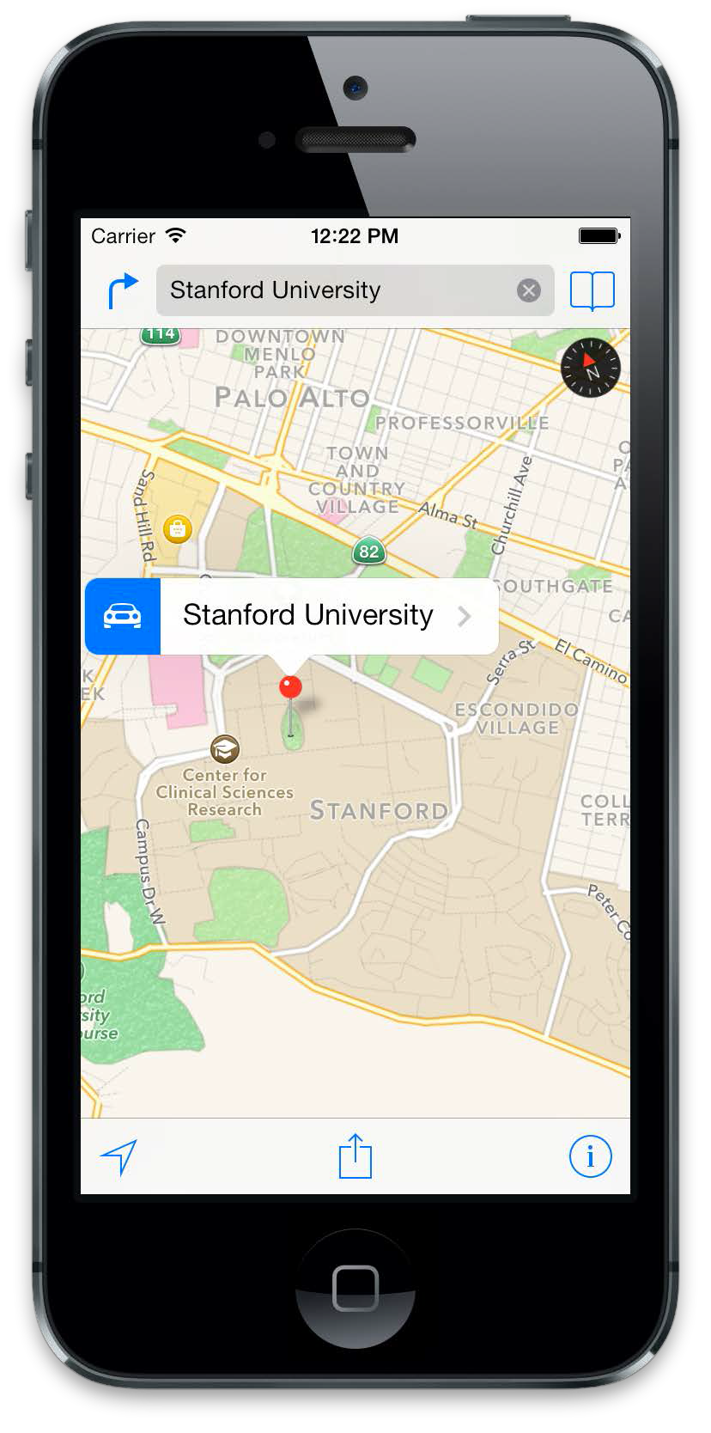
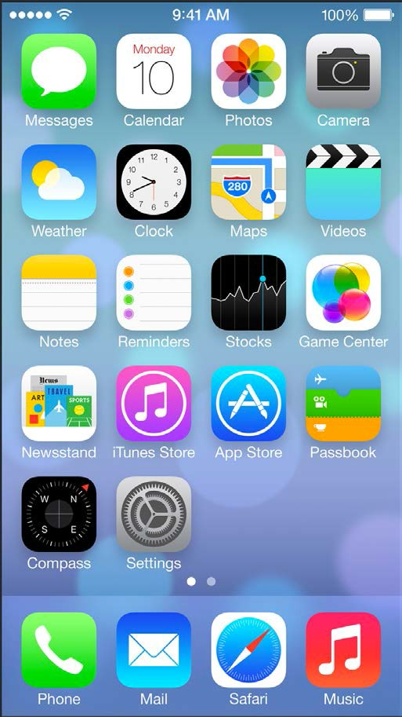
iOS Mobile Development
Instructor: NGUYEN ANH MINH (M. Sc.)

Slide 2
Module 02
Interface Builder
Story Board
UI Design
Auto Layout

Slide 3
Interface Builder

Slide 4
Interface builder
The Interface Builder editor within Xcode makes it simple to design a full user interface without writing any code. Simply drag and drop windows, buttons, text fields, and other objects onto the design canvas to create a functioning Mac, iPhone, or iPad user interface.
Because Cocoa and Cocoa Touch are built using the Model-View-Controller pattern
It is easy to independently design your interfaces, separate from their implementations.

Slide 5
Using Interface builder
Creating Hello World App Using Xcode 6 and Interface Builder
The list goes on and on. Xcode 6 promotes the use of Storyboard instead of Interface Builder. When you create a new Xcode project using the Single View template, it defaults to Storyboard. There is no XIB file generated.
It doesn’t mean we prefer Interface Builder over Storyboard, which is great. We just want you to learn both
Using Interface builder

Slide 6
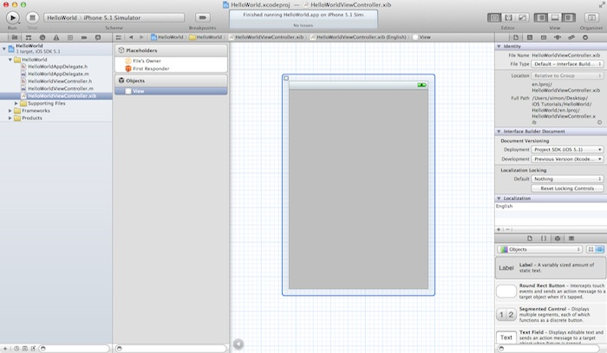
Using Interface builder
.xib – For files with .xib extension, they’re Interface Builder files that store the application’s user interface (UI). As you click on the .xib file, Xcode automatically switches to the Interface Builder for you to edit the UI of the app via drag-and-drop.

Slide 7
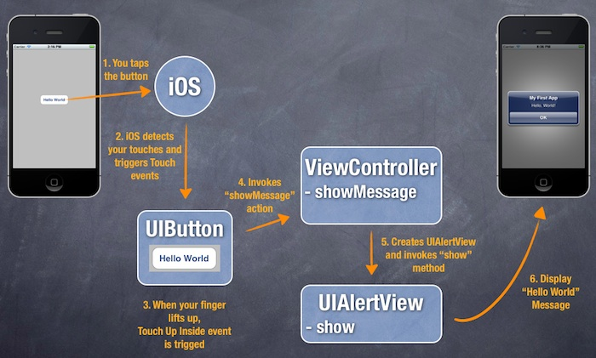
Using Interface builder
Builder HelloWorld Mobile Apps
using Interface Builder

Slide 8
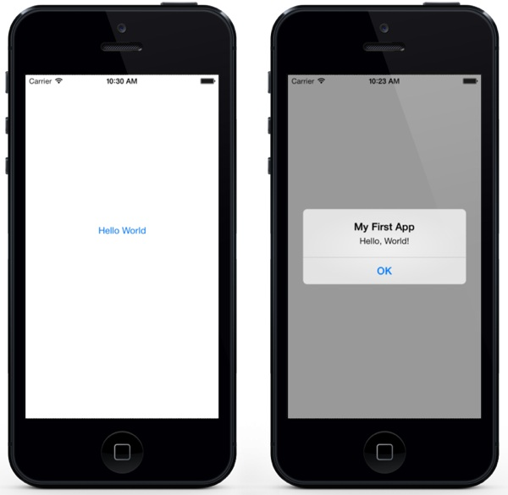
Using Interface builder
It’s very simple and shows
only a “Hello World” button.
When tapped, the app prompts
you a message.
That’s it. Nothing complex but
it helps you kick off your iOS programming journey

Slide 9
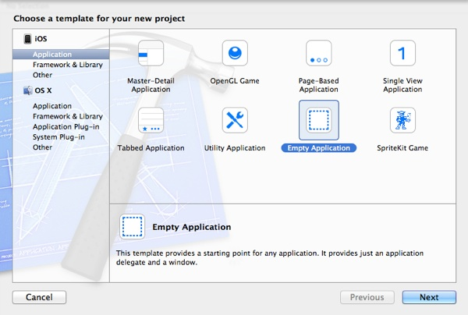
Using Interface builder

Slide 10
Using Interface builder
You can simply fill in the options as follows:
Product Name: HelloWorld – This is the name of your app.
Company Identifier: com.ibsv – It’s actually the domain name written the other way round. If you have a domain, you can use your own domain name.
Class Prefix: HelloWorld – Xcode uses the class prefix to name the class automatically. In future, you may choose your own prefix or even leave it blank. But for this tutorial, let’s keep it simple and use “HelloWorld”.
Device Family: iPhone – Just use “iPhone” for this project.
Use Core Data: [unchecked] – Do not select this option. You do not need Core Data for this simple project.

Slide 11
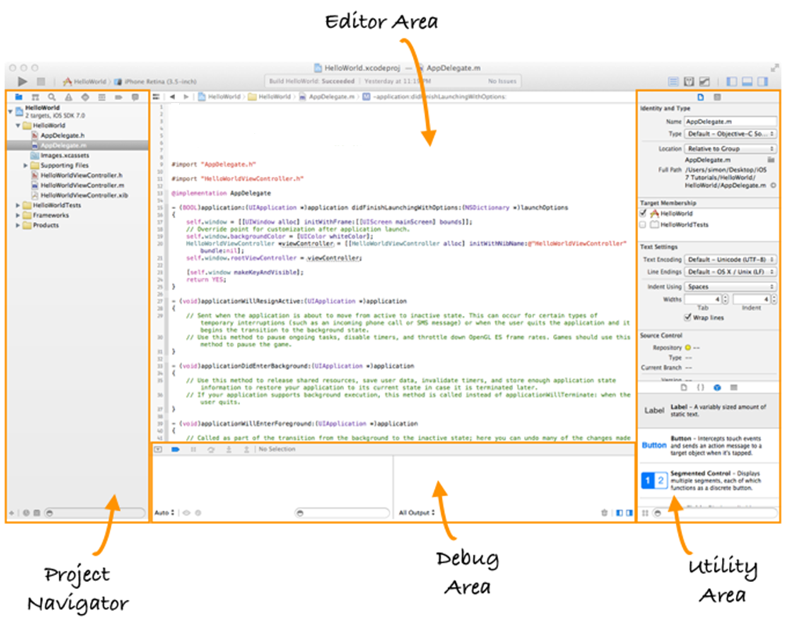
.h and .m – Files with .h extension refers to the header files while those with .m extension are the implementation files. Like most of the programming languages, the source code of Objective-C is divided into two parts: interface and implementation.

Slide 12
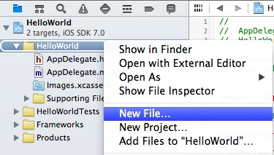
Before we can put a button, we first need to create a view and its corresponding controller. You can think of a view as a container that holds other UI items such as button. Go back to the Project Navigator. Right-click on the HelloWorld folder and select “New File”.

Slide 13
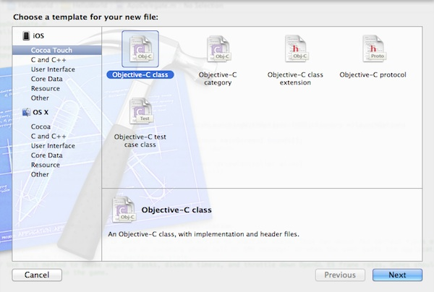
Under the Cocoa Touch category, select the Objective-C class template and click Next.

Slide 14
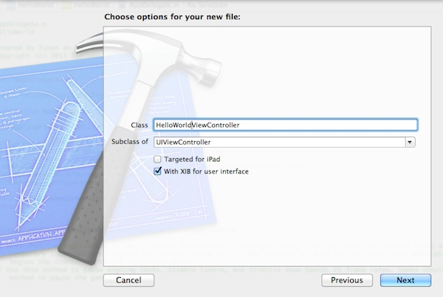
Name the new class as HelloWorldViewController and the subclass as UIViewController. Make sure you check the “With XIB for user interface” option. By selecting this option, Xcode automatically generates a Interface Builder file for the view controller.

Slide 15
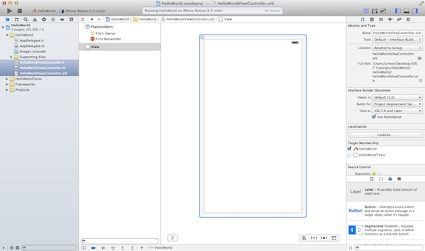
You’ll be prompted with a file dialog. Simply click the Create button to create the class and XIB. Once done, Xcode generates three new files including HelloWorldViewController.h, HelloWorldViewController.m and HelloWorldViewController.xib. If you select the HelloWorldViewController.xib file, you’ll find a empty view similar to the below image:

Slide 16
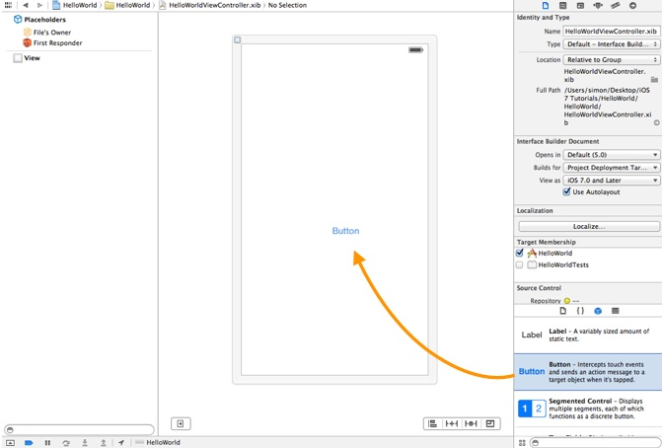
Now we’ll add a Hello World button to the view. In the lower part of the utility area, it shows the Object library. From here, you can choose any of the UI Controls, drag-and-drop it into the view. For the Hello World app, let’s pick the button and drag it into the view. Try to place the button at the center of the view.

Slide 17

Next, let’s rename the button. To edit the label of the button, double-click it and name it “Hello World”.
Select the AppDelegate.m in Project Navigator. Add the following import statement at the very beginning of the file:
#import "HelloWorldViewController.h"
In the didFinishLaunchingWithOptions: method, add the following lines of code right after “self.window.backgroundColor = [UIColor whiteColor]”.
HelloWorldViewController *viewController = [[HelloWorldViewController alloc] initWithNibName:@"HelloWorldViewController" bundle:nil]; self.window.rootViewController = viewController;

Slide 18
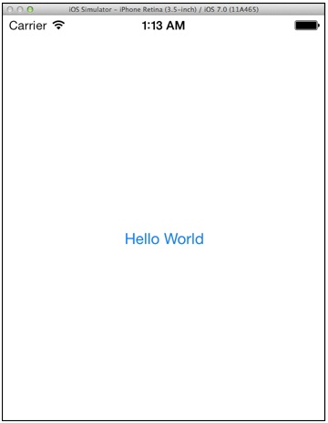
What you have just done is to load the HelloWorldViewController.xib and set it as the root view controller. Now try to run the app again and you should have an app like this:

Slide 19
In the Project Navigator, select the “HelloWorldViewController.h”. The editor area now displays the source code of the selected file. Add the following line of code before the “@end” line:
-(IBAction)showMessage;
Your complete code should look like this after editing:
#import <UIKit/UIKit.h> @interface HelloWorldViewController : UIViewController -(IBAction)showMessage; @end

Slide 20
Next, select the “HelloWorldViewController.m” and insert the following code before the “@end” line:
- (IBAction)showMessage { UIAlertView *helloWorldAlert = [[UIAlertView alloc] initWithTitle:@"My First App" message:@"Hello, World!" delegate:nil cancelButtonTitle:@"OK" otherButtonTitles:nil]; // Display the Hello World Message [helloWorldAlert show]; }

Slide 21
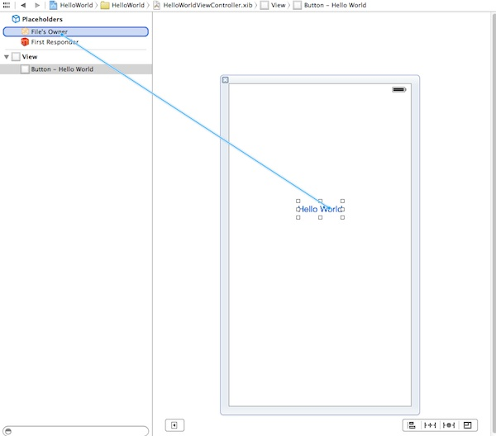
Next up, you’ll need to establish a connection between the “Hello World” button and the “showMessage” action you’ve just added. Select the “” file to go back to the Interface Builder. Press and hold thHelloWorldViewController.xibe Control key on your keyboard, click the “Hello World” button and drag to the “File’s Owner”. Your screen should look like this:

Slide 22
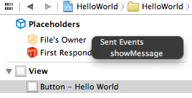
Release both buttons and a pop-up shows the “showMessage” action. Select it to make a connection between the button and “showMessage” action.

Slide 23
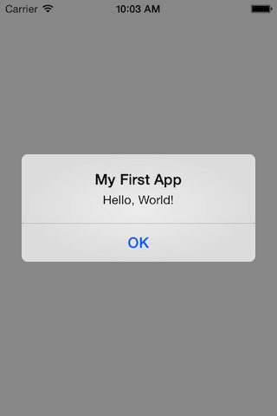
Test Your App ☺
That’s it! You’re now ready to test your first app. Just hit the “Run” button. If everything is correct, your app should run properly in the Simulator.

Slide 24
When to use nibs interface builder?
☺ Simple login and registration views.
☺ Settings and popup windows.
☺Reusable view templates.
☺ Reusable cell templates

Slide 25
When NOT to use nibs?
☹ Views with dynamic content, where the layout changes significantly depending on content.
☹Views that by nature are not easily designable in the Interface Builder.
☹View controllers with complicated transitions that could be simplified with Storyboarding.

Slide 26
UI Design

Slide 27
A user needs to interact with an app interface in the simplest way possible. Design the interface with the user in mind, and make it efficient, clear, and straightforward → MVC
View → (an object whose class is UIView or a subclass of UIView) knows how to draw itself into a rectangular area of the interface.
View Controller → In iOS, this management of the dynamic interface is performed through view control‐lers. A view controller is an instance of UIViewController. Actually, a view controller is most likely to be an instance of a UIViewController subclass; the UIViewController class is designed to be subclassed, and you are very unlikely to use a plain vanilla UIViewController object without subclassing it.

Slide 28
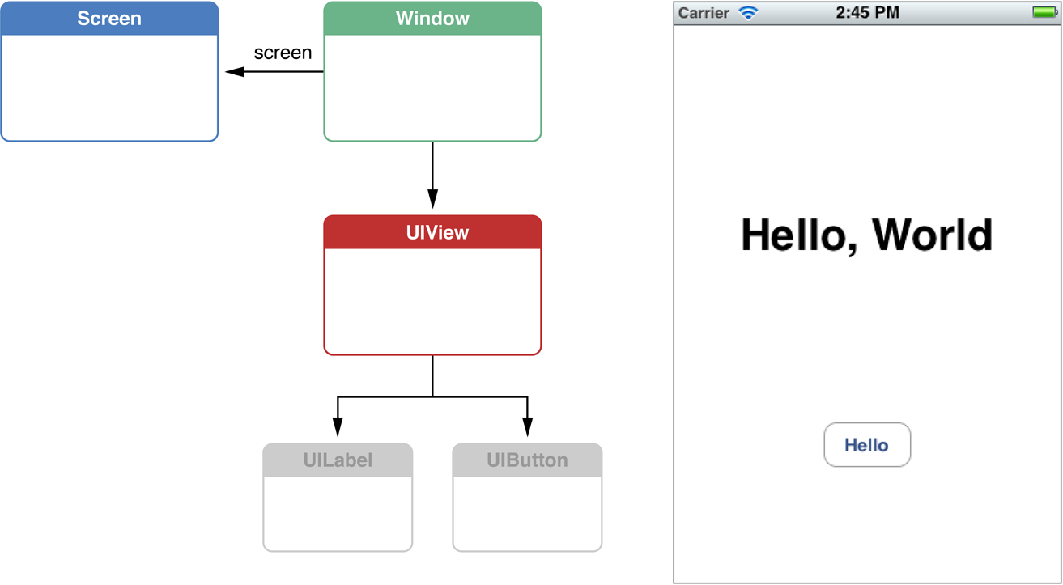

Slide 29
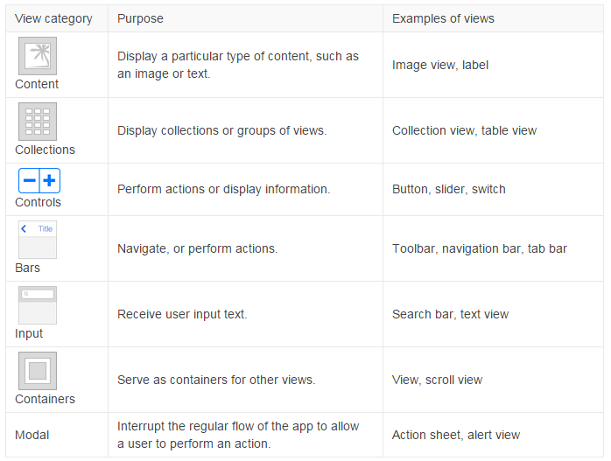

Slide 30
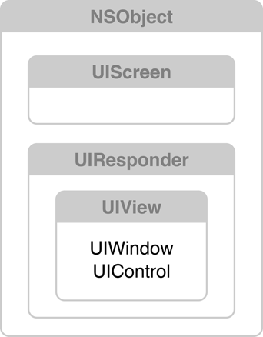
Classes in the View system
There are three major objects at work here:
A UIScreen object that identifies a physical screen connected to the device.
A UIWindow object that provides drawing support for the screen.
A set of UIView objects to perform the drawing

Slide 31
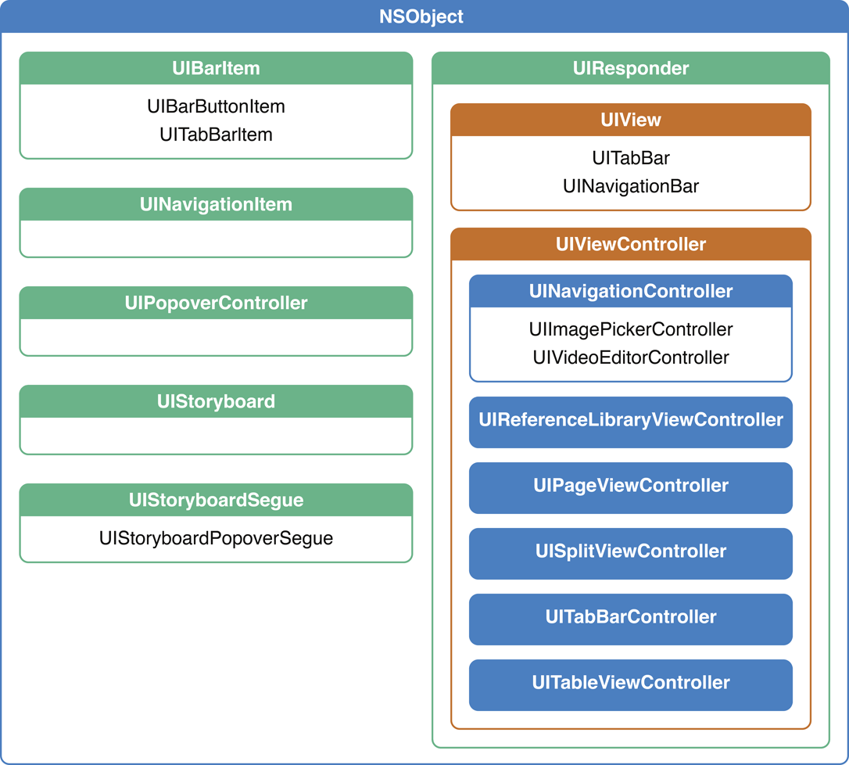
Taxonomy of View Controllers
View controllers are a vital link between an app’s data and its visual appearance. Whenever an iOS app displays a user interface, the displayed content is managed by a view controller or a group of view controllers coordinating with each other. Therefore, view controllers provide the skeletal framework on which you build your apps.
iOS provides many built-in view controller classes to support standard user interface pieces, such as navigation and tab bars. As part of developing an app, you also implement one or more custom controllers to display the content specific to your app.

Slide 32
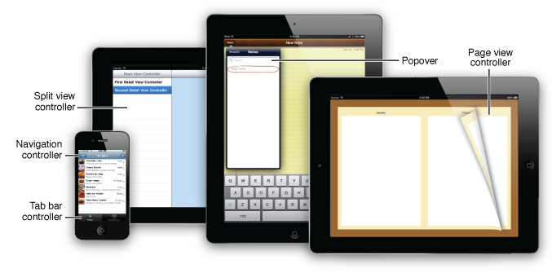
View controllers present and manage a hierarchy of views. The UIKit framework includes classes for view controllers you can use to set up many of the common user interaction idioms in iOS. You use these view controllers with any custom view controllers you may need to build your app’s user interface. This document describes how to use the view controllers that are provided by the UIKit framework.
Parentage (containment)
A view controller can contain another view controller. The containing view con‐troller is the parent of the contained view controller; the contained view controller
is a child of the containing view controller.
Presentation (modal views) A view controller can present another view controller. The first view controller is the presenting view controller (not the parent) of the second; the second view con‐

Slide 33
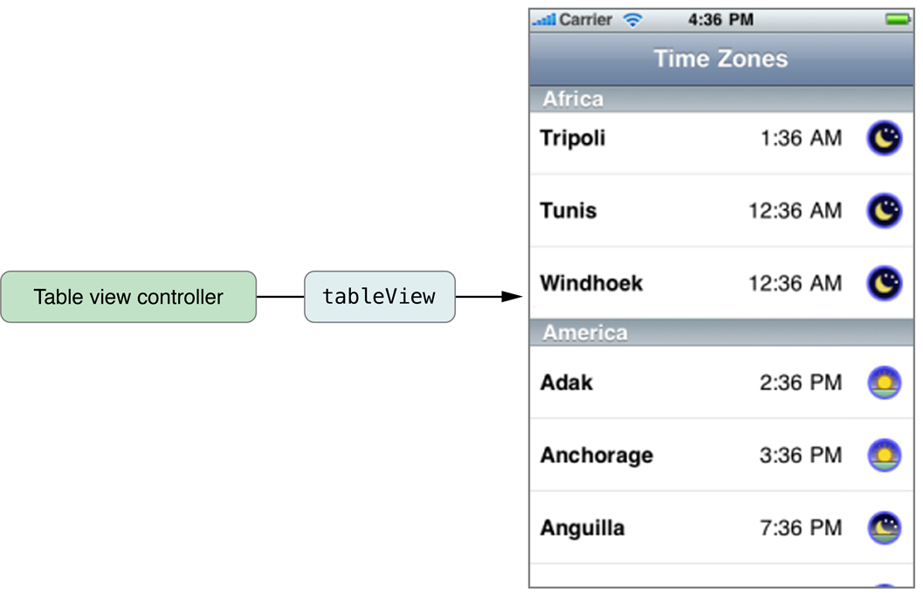
UITableViewController, manages a table view and adds support for many standard table-related behaviors such as selection management, row editing, and table configuration. This additional support is there to minimize the amount of code you must write to create and initialize a table-based interface. You can also subclass UITableViewController to add other custom behaviors

Slide 34
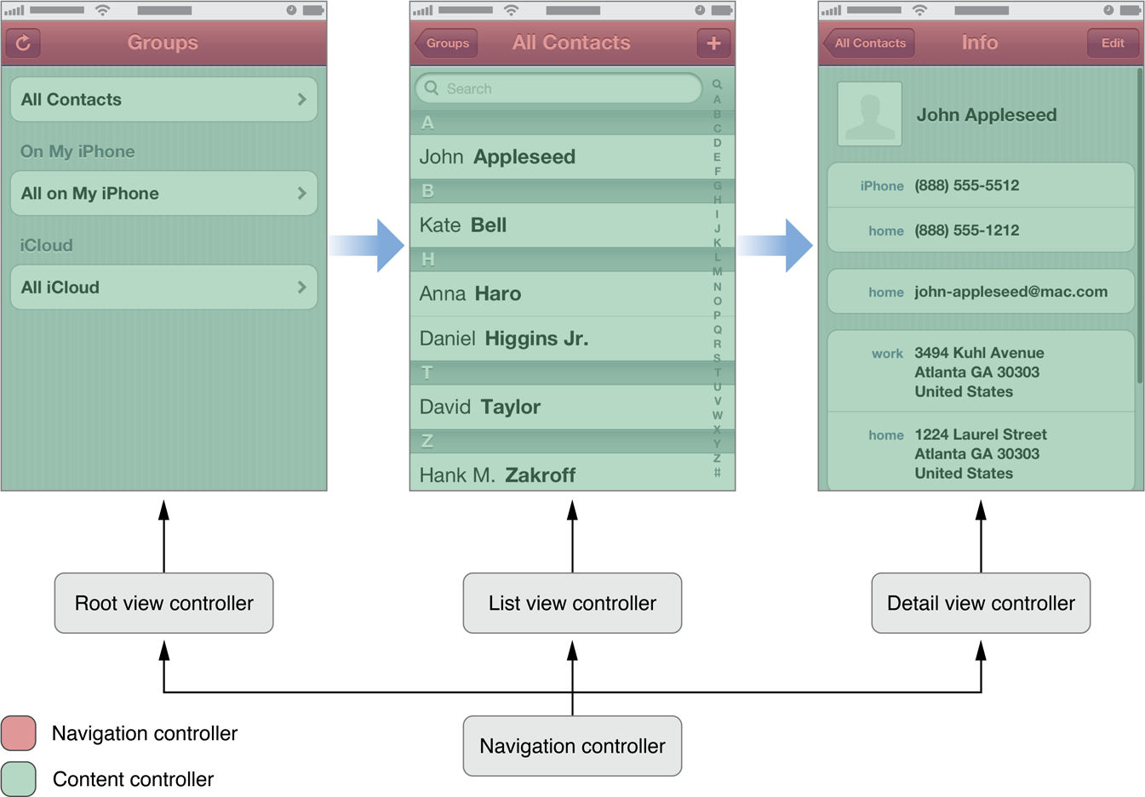
Navigation Controllers
A navigation controller presents data that is organized hierarchically and is an instance of the UINavigationController class. The methods of this class provide support for managing a stack-based collection of content view controllers. This stack represents the path taken by the user through the hierarchical data, with the bottom of the stack reflecting the starting point and the top of the stack reflecting the user’s current position in the data.

Slide 35
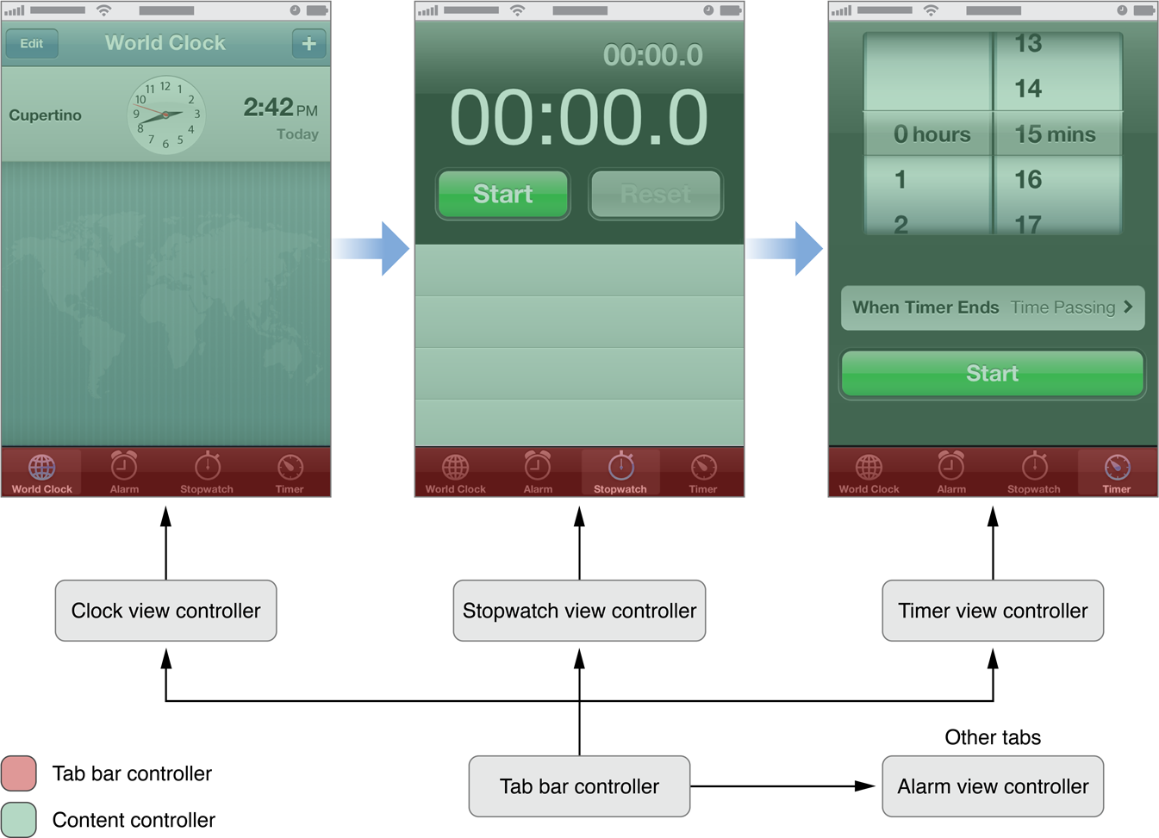
Tab Bar Controllers
A tab bar controller is an instance of the UITabBarController class. The tab bar has multiple tabs, each represented by a child view controller. Selecting a tab causes the tab bar controller to display the associated view controller’s view on the screen.

Slide 36
Story board

Slide 37
Using story board
Storyboards are introduced in iOS 5 and when we use storyboards our deployment target should be 5.0 or higher.
Storyboards helps us visual create all the screens of the application along with their flow of screens under one interface MainStoryboard.storyboard.
It also helps in reducing coding of pushing/presenting view controllers.

Slide 38
Using story board
Like table view, navigation controller is another UI element you commonly find in iOS app.
It provides a drill-down interface for hierarchical content. Take a look at the built-in Photos app, YouTube, and Contacts

Slide 39
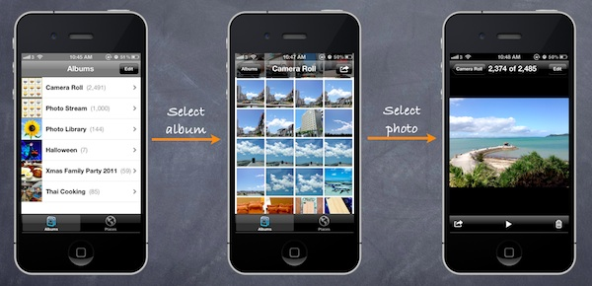
Design of our app

Slide 40
Using story board
X code provides a built-in editor to layout the Story boards
You can define the transition (known as segues) between various screens simply using point and click. This doesn’t mean you do not need to write code for the user interface. But Storyboards significantly reduce the amount of code you need to write

Slide 41
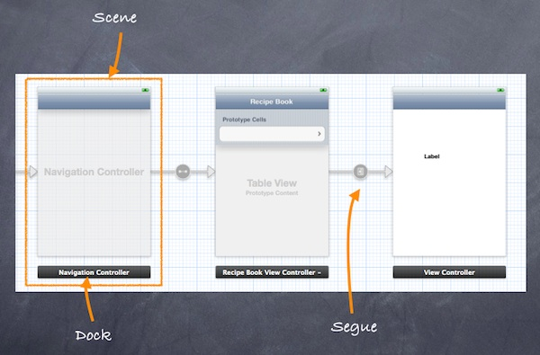
Using story board

Slide 42
Using story board
Scene and Segues
When working with Storyboards, Scene and Segues are two terms you always come across.
Within a Storyboard, a scene refers to a single view controller and its view. Each scene has a dock, which is used primarily to make action and outlet connections between the view controller and its views.
Segue sits between two scenes and manages the transition between two scenes. Push and Modal are two common types of transition.

Slide 43
Steps:
1.Creating Navigation Controller in Storyboards
2.create a new project using “Single View application” template
3.we’ll build a simple app that makes use of both UITableView and UINavigationController.
4.We use the table view to display a list of recipes. When users select any of the recipe, the app navigates to the next screen showing the details. It’ll be easy.
5.create a new project using “Single View application” template.

Slide 44
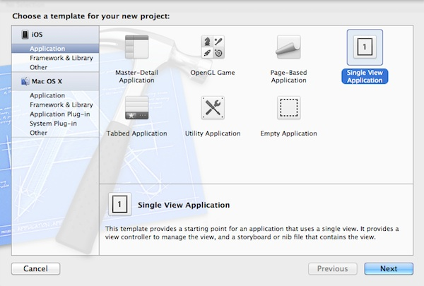

Slide 45
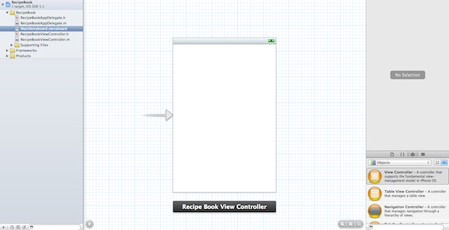

Slide 46
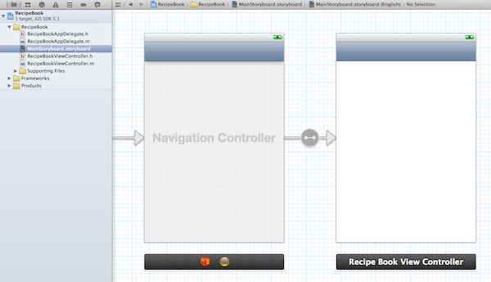

Slide 47
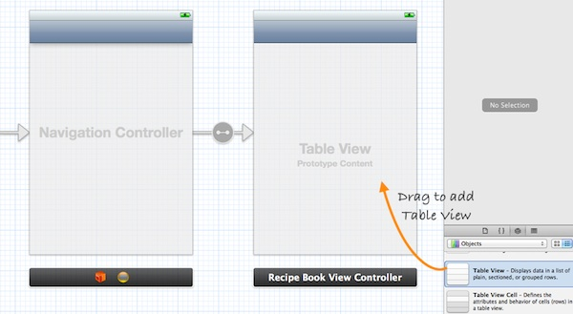
Adding Table View for Your Data

Slide 48
The next thing we have to do is to write code to populate the table data (i.e. recipes). In Project Navigator, select “RecipeBookViewController.h”. Append “” after “UIViewController”. Your code should look like below
#import <UIKit/UIKit.h> @interface RecipeBookViewController : UIViewController <UITableViewDelegate, UITableViewDataSource> @end
Next, select “RecipeBookViewController.m” and define an instance variable (i.e. recipes array) for holding the table data.
@implementation RecipeBookViewController { NSArray *recipes; }
In the “viewDidLoad” method, add the following code to initialize the “recipes” array:
- (void)viewDidLoad { [super viewDidLoad]; // Initialize table data recipes = [NSArray arrayWithObjects:@"Egg Benedict", @"Mushroom Risotto", @"Full Breakfast", @"Hamburger", @"Ham and Egg Sandwich", @"Creme Brelee", @"White Chocolate Donut", @"Starbucks Coffee", @"Vegetable Curry", @"Instant Noodle with Egg", @"Noodle with BBQ Pork", @"Japanese Noodle with Pork", @"Green Tea", @"Thai Shrimp Cake", @"Angry Birds Cake", @"Ham and Cheese Panini", nil]; }

Slide 49
For your reference, this is the complete source code of “RecipeBookViewController.m”.
- (NSInteger)tableView:(UITableView *)tableView numberOfRowsInSection:(NSInteger)section { return [recipes count]; } - (UITableViewCell *)tableView:(UITableView *)tableView cellForRowAtIndexPath:(NSIndexPath *)indexPath { static NSString *simpleTableIdentifier = @"RecipeCell"; UITableViewCell *cell = [tableView dequeueReusableCellWithIdentifier:simpleTableIdentifier]; if (cell == nil) { cell = [[UITableViewCell alloc] initWithStyle:UITableViewCellStyleDefault reuseIdentifier:simpleTableIdentifier]; } cell.textLabel.text = [recipes objectAtIndex:indexPath.row]; return cell; }

Slide 50
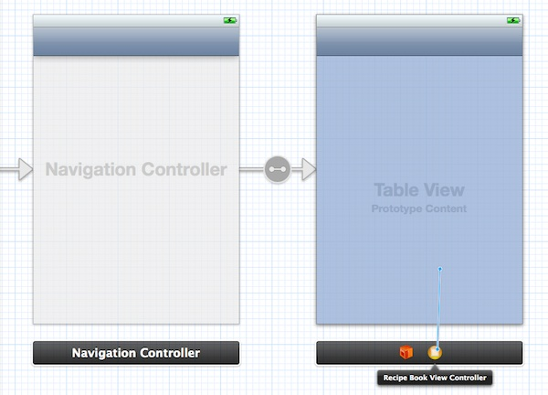
Lastly, we have to establish the connection between the Table View and the two methods we just created. Go back to the Storyboard. Press and hold the Control key on your keyboard, select the “Table View” and drag to the View Controller icon. Your screen should look like this:

Slide 51
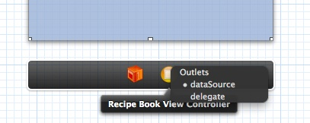
Release both buttons and a pop-up shows both “dataSource” & “delegate”. Select “dataSource” to make a connection between the Table View and its data source. Repeat the above steps and make a connection with the delegate.

Slide 52
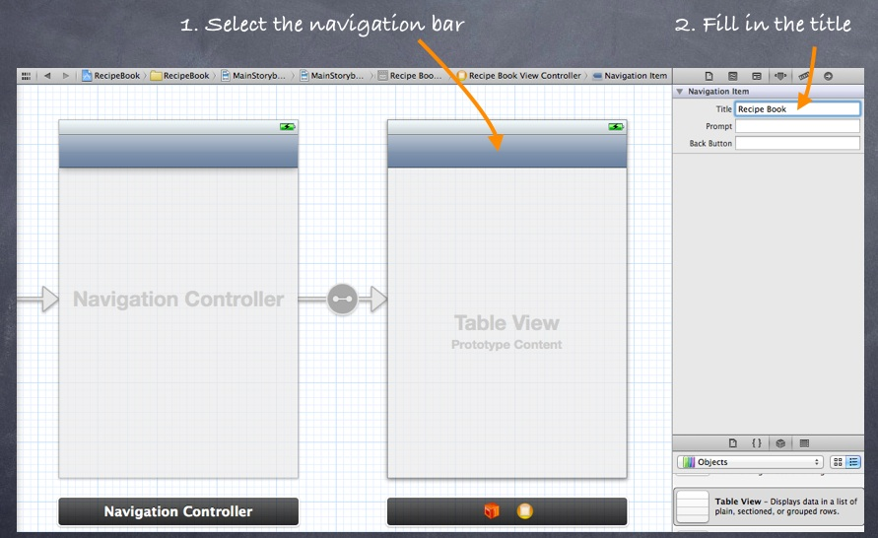
Before we test out the app, one last thing to do is add a title for the navigation bar. Simply select the navigation bar of “Recipe Book View Controller” and fill in the “Title” under “Attributes Inspector”. Remember to hit ENTER after keying in the title to effectuate the change

Slide 53
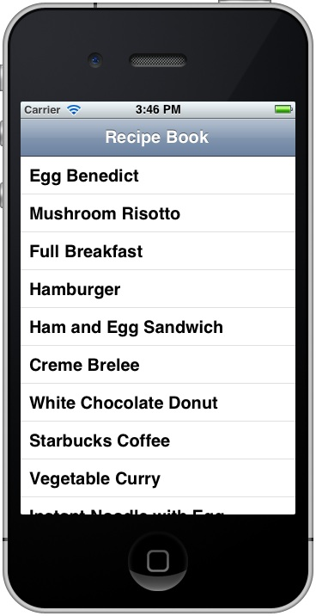
Voila ☺
Now, it’s time to execute your code. Hit the Run button and test out your app. If your code is correct, you should end up with an app displaying a list of recipes.
Notes:
53

Slide 54
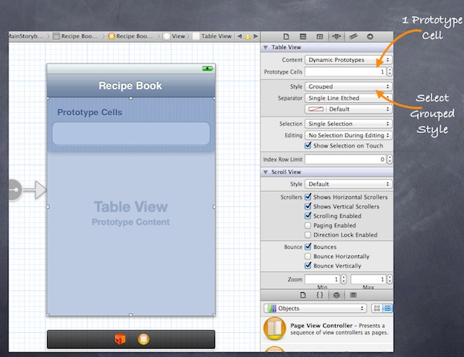
Introducing Prototype Cell
With the introduction of Prototype Cell in Storyboard, it’s much simpler to create a custom cell. Prototype cell allows you to easily design the layout of a table cell right in the Storyboard editor.
To add a prototype cell, select the Table View. Under “Attributes Inspector”, change the “Prototype Cells” value from “0” to “1”. As soon as you change the value, Xcode automatically shows you a prototype cell. In order to show you another table style, let’s also change the “Style” option from “Plain” to “Group”.

Slide 55
Why should we use story board?
Easing navigation flow
Eliminate boilerplate code needed to pop, push, present, and dismiss view controllers. Moreover, view controllers are automatically allocated, so there’s no need to manually alloc and init
Storyboards are best used with multiple interconnected view controllers, as their major simplification is in transitioning between view controllers.

Slide 56
When should we use story board?
For example, it makes sense to use Storyboards when handling:
A set of views for authentication and registration.
A multi-step order entry flow.
A wizard-like (i.e., tutorial) flow.
A master-detail set of views (e.g., profiles lists, profile details).
Meanwhile, large Storyboards should be avoided, including single app-wide Storyboards (unless the app is relatively simple)

Slide 57
Auto Layout

Slide 58
What is Auto Layout?
Auto Layout provides a ﬂexible and powerful system that describes how views and their content relate to each other and to the super views they occupy.
The fundamental building block in Auto Layout is the constraint. Constraints express rules for the layout of elements in your interface.
For example, you can create a constraint that specifies an element’s width, or its horizontal distance from another element. You add and remove constraints, or change the properties of constraints, to affect the layout of your interface

Slide 59
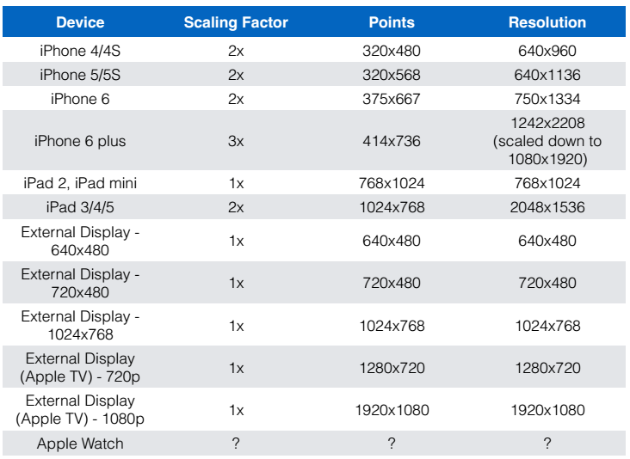
Why do we need Auto Layout?

Slide 60
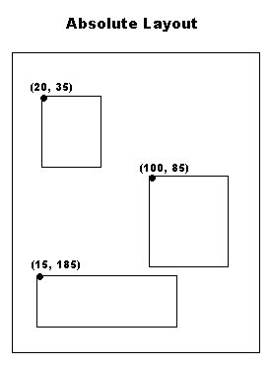
Positioning Views without Auto Layout
view.frame = CGRectMake(10, 20, 50, 100 );
• frame is in superview coordinates
• X Offset (i.e. 10)
• Y Offset (i.e. 20)
• Width (i.e. 50)
• Height (i.e. 100)

Slide 61
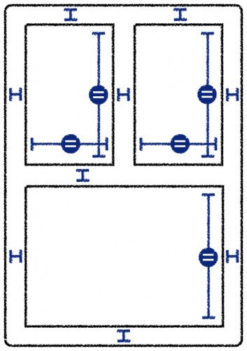
Positioning Views with Auto Layout
Uses Constraints
• Examples:
• “View 1’s X coordinate is positioned 20 points to the
right of its superview’s left coordinate”
• “View 1’s Y coordinate is positioned 20 points below it’s
superviews top coordinate”
• “View 1’s Width is equal to 1/2 of it’s superview’s width”
• “View 1’s Height is equal to 1/2 of it’s superview’s height”

Slide 62
Parts of a Constraint
Constraints
Define relationships between one or two views Stored in a third view which should be the nearest common ancestor of both views.
View 1
• View 1 attribute
• View 2
• View 2 attribute
• Relationship (==, <, >, <=, >=)
• Constant
• Priority
• Multiplier

Slide 63
Ambiguous / Incomplete Constraints
Can cause views to disappear, because
unspecified constraints default to 0. For example,
width or height would be set to 0, making the view
not appear.
• Ambiguous constraints will generate warnings on
the Xcode console

Slide 64
Unambiguous Layout
Usually requires a minimum of 4 constraints. One for
each of the below:
• X
• Y
• Width
• Height
• If a view has an intrinsic size, this satisfies width & height constraints so only need 2 constraints: X & Y constraints

Slide 65
Intrinsic Size
Minimum size (width & height) needed to display the view’s full content without squeezing or clipping content
• Some system controls automatically provide this
• UIButton
• UILabel
• UISegmentControl
• UISwitch
• etc.
• Can define this in custom views using intrinsicContentSize() method
• If intrinsic content size in a custom view changes, call
invalidateIntrinsicContentSize()

Slide 66
X Constraint Attributes
Left - Left side of the view’s alignment rectangle
• Right - Right side of the views alignment rectangle
• Leading - Leading edge of the view’s alignment
rectangle
• Trailing - Trailing edge of the view’s alignment
rectangle
• Center X - Center along the X-axis of the view’s
alignment rectangle

Slide 67
Y Constraint Attributes
Top - Top of view’s alignment rectangle
• Bottom - Bottom of view’s alignment rectangle
• Center Y - Center along the Y-Axis of the view’s
alignment rectangle
• Baseline - The view’s baseline

Slide 68
Width / Height Constraint Attributes
Constraint Priorities
Width - Width of the view
• Height - Height of the view
Range from 1 (lowest priority) to 1000 (required
priority)
• Used to resolve conflicts in constraints

Slide 69
How to apply Auto Layout
Interface Builder
• In code
• Using Visual Format Language

Slide 70
Visual Format Language
Text based format to create constraints in code
• Described in Auto Layout Guide in Visual Format Language
Appendix A
var viewDict = ["view1": view1, "view2": view2]
view1.setTranslatesAutoresizingMaskIntoConstraints(false)
var constraints: NSArray =
NSLayoutConstraint.constraintsWithVisualFormat(
“ H : | - 5 0 - [ v i e w 1 ] - 5 0 - | ",
options: NSLayoutFormatOptions.allZeros,
metrics: nil,
views: viewDict )
self.view.addConstraints(constraints)
• Note that constraintsWithVisualFormat() returns an array of
constraints, not a single constraint

Slide 71
Adding Constraints in Code
Example:
self.view.addConstraint(
NSLayoutConstraint(
item: self.view1!,
attribute: NSLayoutAttribute.Leading,
relatedBy: NSLayoutRelation.Equal,
toItem: self.view,
attribute: NSLayoutAttribute.Leading,
multiplier: 1.0,
constant: 0
)
)

Slide 72
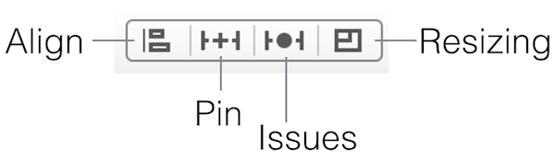
How To Use Auto Layout in Interface Builder
First, set up a new project based on the Single View Application iOS app template. In the project options, choose iPhone for the device family, save the project, then open the Storyboard. You will notice a menu at the bottom-right corner. The buttons in the menu are related to Auto Layout. You can use for alignment, sizing, spacing and resolving constraint issue
Align – Create alignment constraints, such as aligning the left edges of two views.
Pin – Create spacing constraints, such as defining the width of a UI control.
Issues – Resolve layout issues.
Resizing – Specify how resizing affects constraints.

Slide 73
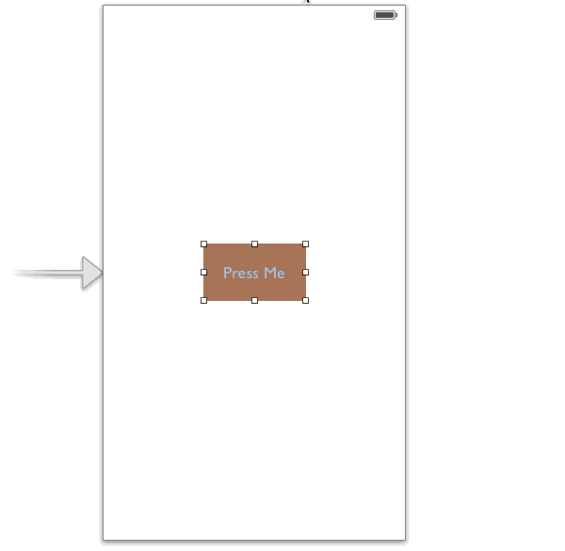
Other than the Auto Layout menu, Apple has made it flexible for developer to setup Auto Layout by using Control+drag. You simply control-drag from any view to another view to set constraints between each other. When you release the mouse, it presents a list of possible constraints for you to select from.

Slide 74
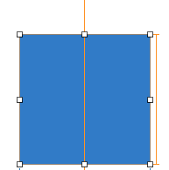
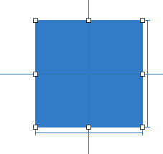
Once you setup a constraint in a view, the constraint line is displayed in either in orange or blue. The orange constraint lines indicates that there are insufficient constraints and you need to fix it.
The blue constraint line indicates that your view layout is being setup correctly and there is no ambiguity.

Slide 75
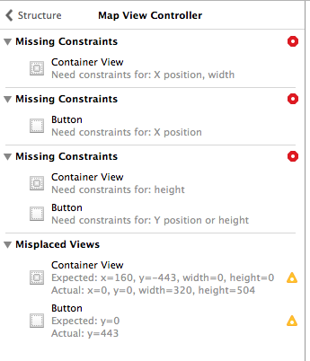
Sometimes after you create the constraint, the Interface Builder outline view shows a disclosure arrow. The red arrow also indicates that there are conflicts or ambiguities. Click the disclosure arrow, and you’ll see a list of the issues. The issues are displayed on a scene-by-scene basis. Typical issues include missing constraints, conflicting constraints and misplaced views.

Slide 76
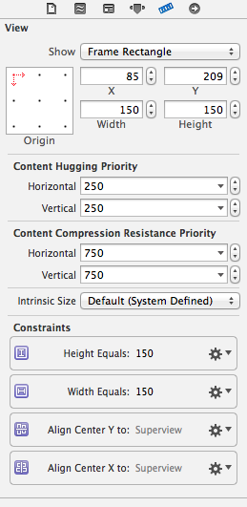
In the Size Inspector, you can view a list of all the constraints that have been added. These constraints appear in a section called “Constraints”.

Slide 77
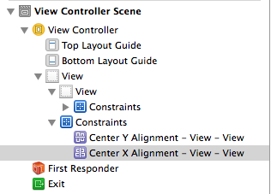
In addition to the size inspector view, the constraints also appear in the Interface Builder Outline under the corresponding view.

Slide 78
Auto Layout Example – Center a Button or Image
By now, you should have a basic understanding of Auto Layout and how you can configure constraints. Let’s consider the example again and see how we can center a button or an image.
As mentioned before, Auto Layout is a constraint-based layout system. It allows developers to create an adaptive interface that responds appropriately to changes in screen size and device orientation. Okay, it sounds good. But what does the term “constraint-based layout” mean? Let me put it in a more descriptive way. Consider the “Press Me” button again, how do you describe its position? Probably you’ll describe like this.
Here you already define two constraints (centered horizontally and centered vertically). These constraints express rules for the layout of label in the interface. Auto Layout is all about constraints. The constraints, however, are expressed in mathematical form. For example, if you’re defining the position of a button, you might want to say “the left edge should be 30 points from the left edge of its containing view.” This translates to button.left = (container.left + 30).
The button should be centered both horizontally and vertically, regardless of the screen size.

Slide 79
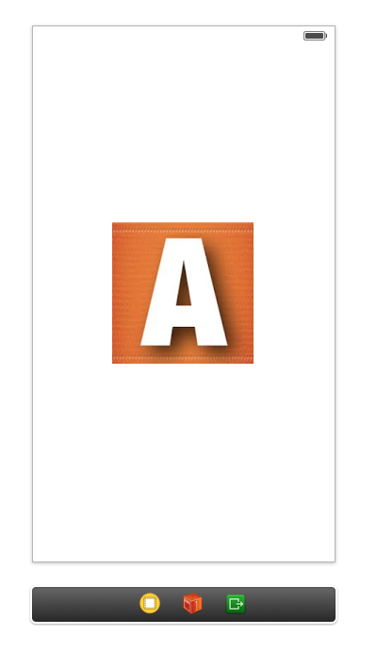
Okay, that’s quite enough for the Auto Layout concept. Now let’s see how to center an image view in the middle of the screen regardless of the screen size and orientation (portrait / landscape).

Slide 80
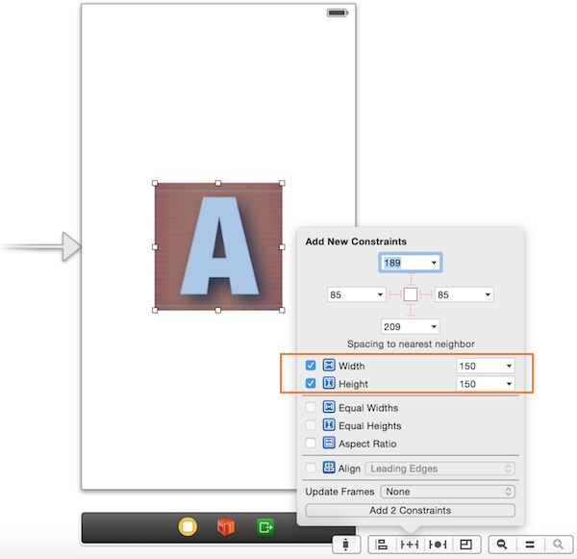
Assuming you’ve added an image view and placed it in the center of the view, the first step is to add the width and height constraints. In this example, we’ll show you how to use Auto Layout menu to apply the constraints. Select the image view and then click the Pin icon in the Auto Layout menu. Select height and width, then hit the “Add 2 constraints” button.

Slide 81
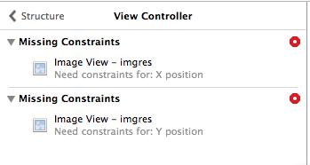
You may notice that a red arrow appears in the Interface Builder outline. This tells us that there are some constraint problems with our image view. Xcode can help us fix them. Simply click on that red arrow, followed the red indicator and finally click “Add missing constraints”.

Slide 82
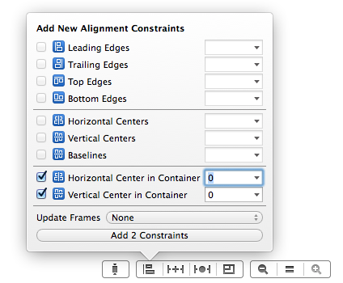
Okay, we have set the size constraints. Next we’ll set another constraint to centre the image view even if the users rotate the device to landscape orientation. To do that, select the image view and click the Alignment icon in the Auto Layout menu. In the pop-over menu, select both “Vertical center in container” and “Horizontal center in container” options, followed by clicking the “Add Constraints” button.

Slide 83
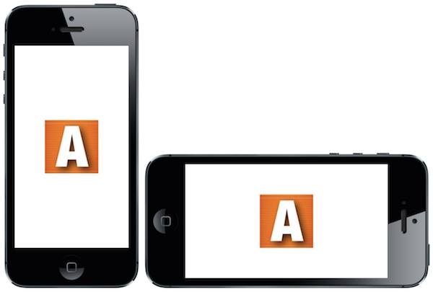
Now you’re ready to test your app. Compile and launch the App. Try to switch between portrait and landscape mode. You will see that the image view stays centered.

Slide 84

Here we just demonstrate how to use Auto Layout menu to add constraints. You can do the same thing by using control-drag. The below image illustrates how it can be done.

Slide 85

Auto Layout Example – Login Button
As you know, the display of iPhone 5 and iPhone 4 are of different size. It will need some tweaks to support both screen size. Consider the below login screen, the login button is placed at the bottom of the view. If you haven’t applied Auto Layout, the app may not be able to display the login button on a 3.5-inch device.

Slide 86

So how can you resolve this issue? Again, to fix that we need to setup a constraint to make it stay to the bottom of the screen. On top of that, its width should be changed when it’s in the landscape mode.
First we’ll add a size constraint for the height of the button. We only add a constraint for the height as the width will change depending on the device’s orientation. control-drag vertically the button and choosing “height”, then fix the ambiguity in the Interface Builder Outline by adding all the missing constraints.
To ensure the button maintains the same distance from the sides of the view (whether it’s in portrait or landscape mode), we need to add another constraint. Control-drag from the button to the left side of the superview and select “leading space to the container”. Repeat the same procedure for the right side and select “trailing space to the container”.

Slide 87


The last step is to add a constraint such that the button stays to the bottom of the view. Control-drag from the button to the bottom of the superview and select “bottom space to bottom layout”.

Slide 88

☺ Voila, Now, you can build and run the project on any devices. Thanks to Auto Layout. The login button should display correctly on 3.5-inch iPhone. And the login button scales proportionally when the device is rotated.

